Slide 1
Filing Status Married, Single, and More
Pub 4012 – Tab B
Pub 4491 – Lesson 5
Notes:
Slide deck Release 2 additions:
#11: changed order of text to keep “recently widowed” separate from head of household
#12: added “if recognized in your state” to mention of common law marriage
#29: removed reference to head of household when married to a non-resident alien and added speaker note to see Slide Deck 10
#41: removed entire text and replaced with “See Slide Deck 10 Unique Filing Status”
The first slides cover the core material for Filing Status
There are many more slides than are needed for Instructors to present this tax topic
Instructors should choose those slides necessary to prompt discussion depending on the experience level of their volunteers
Key Slides for new Volunteers include: 3, 8, 9, 14, 17, 18, 20
For returning volunteers only slide 8 may be needed to prompt discussion
This slide set can also be a good review resource for those certifying through self-study
The following comprehensive topic for Filing Status are at the end of the presentation:
Slides 30 - 33: Married Filing Separately Community Property States
Slides 34 - 41: Injured Spouse

Slide 2
Filing Status
Two criteria:
Marital status on last day of tax year
Federal definition – “married”
Legal marriage under laws of any state or country
Does not include civil unions or registered domestic partners
Family members living in the home (may or may not be dependents) or supported by taxpayer
Notes:
2
U.S. state includes the district of Columbia and U.S. territories
Dependent: An individual who may be claimed as a dependent on another person’s tax return; that is, someone who meets all applicable dependency tests
Will discuss dependents in a later lesson
Note there are circumstances where a non-family member can be a dependent, but only family members can make a taxpayer eligible for Head of Household or Qualifying Widow(er) Filing Status
There is no requirement for taxpayers to substantiate their marriage – their statement that they are married is enough

Slide 3
Five Choices for Filing Status
Single
Married filing jointly (MFJ)
Married filing separately (MFS)
Head of household (HoH)
Qualified widow(er) (QW)
Notes:
Head of Household Filing Status:
This filing status is generally for unmarried taxpayers who paid more than half the cost of keeping up a home for a qualified dependent relative during the tax year
If treated as unmarried for HoH purposes, it does not mean they are not married for other purposes
Married Filing Jointly:
Filing status for taxpayers who are married to each other or live together in a common law marriage and combine their income and deductions on the same tax return
The status also applies to taxpayers who are separated but not divorced and to taxpayers whose spouse died during the tax year and has not remarried, as long as one tax return is used for both individuals
Married Filing Separately:
Filing status for taxpayers who are married to each other and report their incomes and deductions on separate returns
Qualifying Widow(er) with Dependent Child:
Filing status is for widow or widower with one or more dependent children for two years following death of spouse
Single Filing Status:
Filing status that applies to a taxpayer who (1) has never married, or (2) is legally separated (Court Document!) or divorced, or (3) is widowed and is a not qualified widow(er)

Slide 4
Form 1040

Slide 5
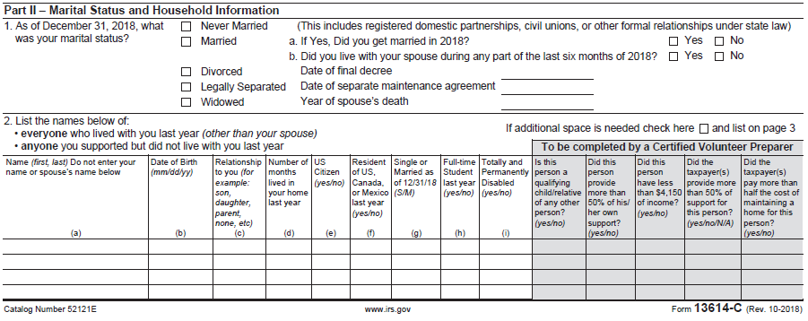
Intake Booklet
Check Part II entries in Intake Booklet
Ask questions – verify
Notes:
Note: The Taxpayer only tells us their marital status. The Counselor must determine the correct and most advantageous filing status based on a thorough interview with the taxpayer!

Slide 6
Living Situation Analysis
Marital status as of 12/31
Others living in home and/or supported by taxpayer, if any
Their relationship/dependency
Paid >50% of upkeep of the home?
If widow(er)
Date of death of spouse
Any dependent* children at home
* See next slide

Slide 7
Qualifying Widow(er)
Child must be a dependent or
Would have been a dependent except
Gross income too high,
Filed MFJ -OR-
Taxpayer is a dependent
Applies to all open tax years – can amend to get a refund

Slide 8
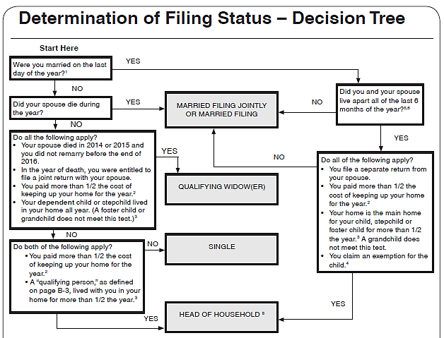
Use the Decision Tree
On the Tri-Fold
Resource Tool
Don’t miss
the footnotes
Also see Tab B-6 in
Pub 4012 for interview
Tips
Notes:
The Decision Tree is not included in Pub 4012. Volunteers will need to refer to the Tri-Fold Resource Tool
Direct Volunteers to open Pub 4012 to Page B-6 and lead a discussion using the Interview Tips

Slide 9
Filing Status Importance
Many tax items affected by filing status
Necessity to file a return
(Pub 4012 Tab A Chart A)
Standard deduction
(Pub 4012 Tab F Exhibit 1)
Tax rate bracket
Eligibility for certain credits
(e.g. Pub 4012 Tab I EIC General Eligibility Rules Step 3)
Notes:
9
Direct Volunteers to open Pub 4012 to these tabs to review the effects

Slide 10
Filing Status – Tax Rate
Initial rates of tax – 2018
Status | Tax Rate is 10% on taxable income | Tax Rate is 12% on taxable income of
Single | Up to $ 9,525 | $ 9,526 – $38,700
Married Filing Jointly | Up to $19,050 | $19,051 – $77,400
Married Filing Separately | Up to $ 9,525 | $ 9,526 – $38,700
Head of Household | Up to $13,600 | $13,601 – $51,800
Notes:
Qualifying widow(er) uses MFJ tax rates

Slide 11
Single
Not married as of December 31
Married, but legally separated
There may be a more advantageous filing status if:
Have qualifying persons
Paying >50% of the home’s upkeep
See Qualifying Widow(er) (if recently widowed) or Head of Household
Notes:
Legally separated involves a court document; a private contract is not enough
Some taxpayers will mark “Legally Separated” on the I&I Sheet when they are simply not living together anymore. It is important to ask if they have a court document
As of 3/18, all states recognize “Legally Separate” EXCEPT Delaware, Florida, Georgia, Mississippi, Pennsylvania and Texas. Verify your state policy

Slide 12
Married Filing Jointly (MFJ)
Married on last day of year
Includes common law marriage if recognized in your state
Spouse died during current tax year/not remarried
Generally, most advantageous filing status
Notes:
One return combining income and deductions of both spouses
On last day of year:
Married and live together
Live apart but not legally separated or divorced
Live together in recognized common law marriage
Separated but divorce decree not final
Spouse died during year/not remarried
New for 2018: Married taxpayers who didn’t live together at the end of 2018 and file MFJ are required to file when gross income is at least $5

Slide 13
Married Filing Separately (MFS)
Married on last day of year
Includes common law marriage
Each spouse files their own tax return
The spouse’s Name and SSN must be entered on the return
Reasons for MFS
Taxpayer chooses to file MFS
Spouse has already filed MFS or HoH
Married but separated and not filing MFJ
Notes:
Note some taxpayers believe they can file single when they have been separated for a long period of time and have no idea of the location of their spouse.
New for 2018: Married taxpayers filing MFS are required to file when gross income is at least $5

Slide 14
MFS Disadvantages
Highest tax rate/lower standard deduction
85% of Social Security benefits are taxable if lived with spouse at all during the year
Cannot claim most tax credits
Cannot deduct student loan interest
Cannot use standard deduction if spouse itemized‏
Notes:
MFS – Lived With Spouse Anytime During The Year
Cannot claim credit for the elderly or the disabled, cannot claim education credits, EIC
Must include social security benefits as income (up to 85% can be taxable)‏, unless lived apart the whole year

Slide 15
Married Filing Separately
Extra questions for MFS
Read requirements carefully – spouse has NO gross income
Makes 85% of social security benefits taxable
Spouse is NOT a dependent and does not qualify for new “credit for other dependents.”

Slide 16
Why File MFS?
No liability for spouse’s tax obligation (except in community property states, perhaps)
Lower combined tax
Itemized deductions limited by lower separate AGI (e.g. medical)‏
Lower repayment of Advance Premium Tax Credits (ACA)
Refund is not offset by spouse’s outstanding tax or other debts (see Injured Spouse – Comprehensive Topic as an option)
Spouse is nonresident alien and does not elect to be treated as a resident (see Unique Filing Status lesson)

Slide 17
Head of Household – Unmarried
Provided home* for qualified child
Might not be a dependent
Provided home* for related dependent
>50% cost of maintaining home for dependent parents living elsewhere
* Paid more than 50% of cost of keeping up the home
Notes:
The trifold laminate can be helpful in determining head of household filing status.

Slide 18
Head of Household – Married
Lived apart all of last 6 months of year
Provided home* for:
Child, stepchild, or eligible foster child for over six months
No other relatives qualify
Key advantages
Higher standard deduction than Single or MFS
Advantageous tax rate structure
* Paid more than 50% of cost of keeping up the home

Slide 19
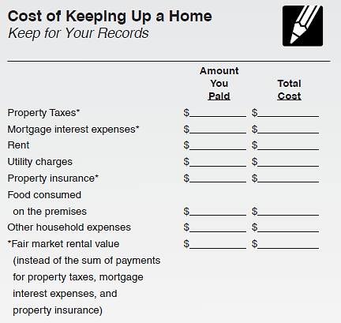
Head of Household – Providing a Home
Pub 4012 Tab B
Open Pub 4012
Tab B Cost of Keeping Up a Home
Note – Can use value of housing and apply new rule to open years

Slide 20
Qualifying Widow(er)
Spouse died in one of two past years
Dependent* child and/or stepchild lived in home all year
Grandchild not eligible
Maintained home (>50% of cost) for child
Can file QW for two years only
Advantages
Standard Deduction – same as MFJ
Uses MFJ tax rates
* Or would have been a dependent but for gross income, joint return, or taxpayer is a dependent tests
Notes:
Must have been eligible to use MFJ year of death
Use QW for two years following year of death (if eligible)

Slide 21
Special Notes
Child is considered to have lived with taxpayer all year if born or died during year (but not stillborn)
Child who is a dependent of a non-custodial parent under Rules for Divorced or Legally Separated Parents still qualifies custodial parent for HoH filing status if all other requirements met

Slide 22
TaxSlayer – Filing Status
Refer to Pub 4012 Entering Basic Information Section
Caution: Changing the filing status during return preparation may delete the state return, if any
Notes:
Instructors should direct volunteers to open Pub 4012 and review the section on entering filing status in in the Entering Basic Information Section

Slide 23
Quality Review
Review is more than just checking that a box is checked – need to ask probing questions
Review prior year’s status
Verify current year filing status with data on Intake Sheet
Is this the correct and most advantageous filing status for the taxpayer?

Slide 24
Filing Status - Quiz #1
Mr. Buck provides total support for his two young children
His wife died in 2014, and he has not remarried
What is the best filing status for Mr. Buck?
Head of Household
What would have been best if his wife died in TY2016?
Qualifying Widower

Slide 25
Filing Status - Quiz #2
Jane, 69, whose husband died July 1 of the current tax year, had a $20,000 pension and $15,000 in social security in the tax year
Her 10-year-old grandson lived with her and is her dependent
What is the best filing status for Jane
MFJ
Assuming nothing changes, what filing status is best for next year?
Head Of Household
Notes:
Instructor follow-up: Why isn’t she eligible for Qualifying Widow?

Slide 26
Filing Status - Quiz #3
Luke and Linda are still married, but chose to live apart for most of the year
Their two children lived with Linda all year
In July, Luke was out of a job so he moved back in the house for just that month
What filing status can they each choose?
MFJ or MFS (both must use same status)

Slide 27
Filing Status - Quiz #4
Peter is single
Peter’s mother lived with him until March last year
In March Peter moved his mother to a nursing home and he pays for her room and care
What is Peter’s best filing status?
Head of Household
Notes:
Instructor follow-up: What if it was his older sister instead of his mother?

Slide 28
Filing Status

Slide 29
Filing Status – Comprehensive Topics
Slides 30-32: Married Filing Separately Community Property States
Slides 33- 40: Injured Spouse
Notes:
If taxpayer is married to a non-resident alien, see Slide Deck #10 for filing status options

Slide 30
Community Property States – Community Income
Identifying and splitting community income may be necessary
MFS or HoH (if married considered unmarried)
Divorced/separated during the year
Registered domestic partnerships (RDP) when state community property laws apply (CA, NV and WA)
Income splitting may be out of scope for community property states
Check with your District or State Coordinator
Notes:
Identifying and splitting community income are difficult legal issues – affected taxpayers should be referred to a paid preparer
Community property (income) laws vary by state
When the community exists at all during the year, income splitting is likely necessary

Slide 31
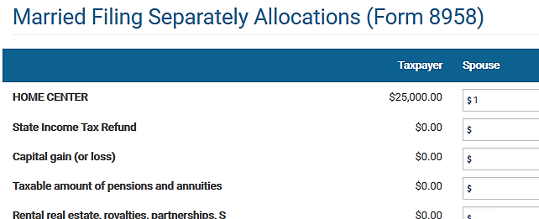
Filing MFS (or Single and RDP) in a Community Property State
Complete Form 8958 if in community property state
Enter $1 for spouse
Notes:
The $1 can be on any line that has an amount
To be confirmed in 2018 release of the tax software

Slide 32
Married Filing Separately – Community Property States
If in a community property state, will get this warning if try to e-file without Form 8958
Notes:
MFS returns may be out of scope in a community property state due to the complexities of identifying and splitting community income
Community property states include: AZ, CA, ID, LA, NV, NM, TX, WA, and WI

Slide 33
Injured Spouse
A common reason taxpayers choose MFS is to avoid an offset of their refund against their spouse’s outstanding debts such as:
Past due child or spousal support
Federal nontax debts, e.g. student loans
Federal or state tax debts
State unemployment debts
In this case filing MFJ with Form 8379 Injured Spouse Allocation is an alternative

Slide 34
Injured Spouse Requirements
Filing MFJ and only one spouse owes past due amounts
The MFJ return reflects an overpayment
The “Injured Spouse”
Must NOT be legally obligated to pay those debts
Must have made and reported tax payments (such as withholding) or claimed a refundable tax credit (i.e. they are due a refund)
Notes:
In community property states, both spouses are liable for community debts

Slide 35
Form 8379 Injured Spouse Allocation
Form 8379 can be filed by itself if the joint return has been filed and the refund was offset
Include copies of all forms for both spouses that show income tax withheld

Slide 36
IRS Form 8379 (partial view)

Slide 37
TaxSlayer Injured Spouse
Refer to Pub 4012 Tab O Navigating TaxSlayer for Injured Spouse
Proceed to the Injured Spouse Form 8379
Note the warning that the form does not guarantee outcome and can delay the refund up to 14 weeks

Slide 38
TaxSlayer Form 8379 Input
The counselor must thoroughly review all tax documents to allocate the proper amount of income, deductions, additional taxes, taxes withheld, and credits to the injured spouse
Do not allocate EIC, the IRS will determine that allocation

Slide 39
Filing Status – Quiz #5
Jack and Jill Murphy are married and want to file MFS because Jack owes back child support and their refund will be offset
What other options do they have?
What probing questions do you ask?

Slide 40
Problem #5 (Cont.)
They can file MFJ with Form 8379 Injured Spouse Allocation
Probing questions:
Is Jill legally obligated to pay any of the debts?
Did Jill make and report tax payments (such as withholding) or claim a refundable tax credit?

Slide 41
Head of Household – Married to Non-Resident Alien
See Slide Deck 10 Unique Filing Status

Slide 42
Filing Status

